Slide 1

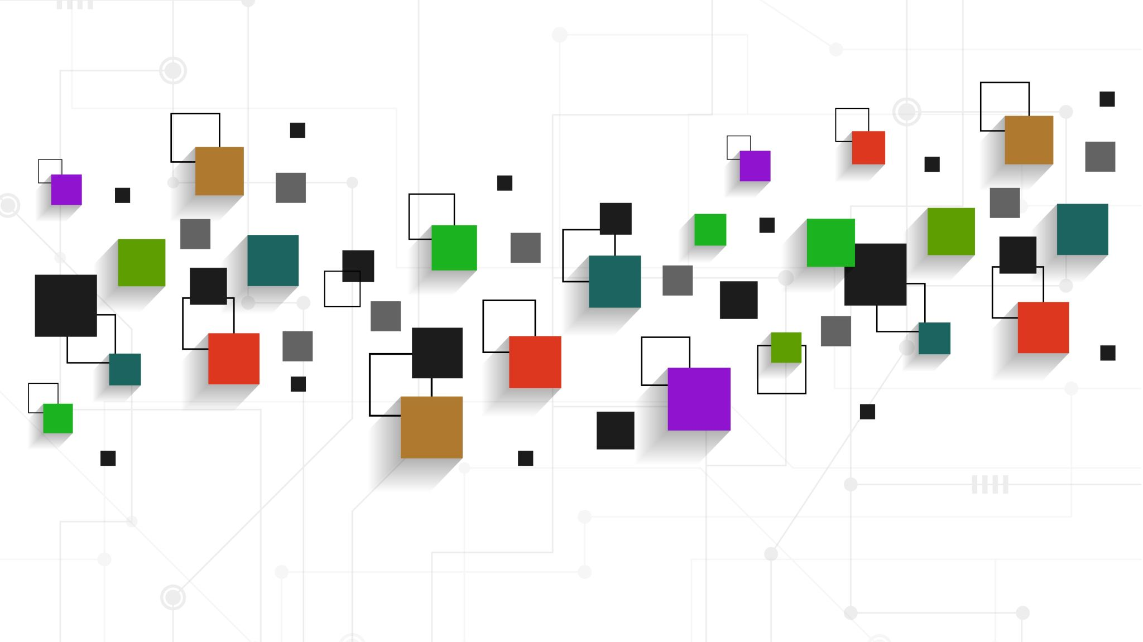
Introduction to Software Business Product Management
Week 2 Day 3
Led by: Emily Crose
for
Oakland University

Slide 2
Day 2 Recap

Slide 3

Questions From Day 2?

Slide 4
Terms To Listen For
Application Programming Interface (API)
Enables automated, programmatic retrieval of information using a standard framework.
Authentication
Refers to the process of verifying a user’s identity.
Rate-Limit
How many requests can occur at a given time.

Slide 5
Application Programming Interfaces (APIs)
What do they do for applications?
How do they work?

Slide 6
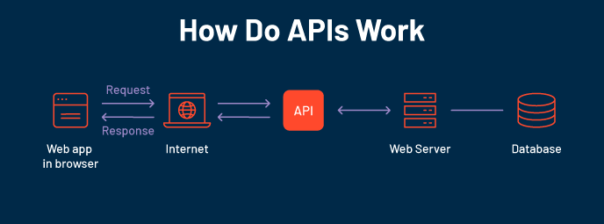

Slide 7
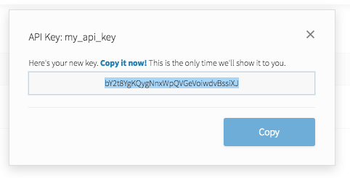
API Key
Notes:
API keys are meant to be kept secret. Why? Because they include information related to one specific account.

Slide 8

Why Do We Need API Keys?
Account verification
Who is requesting what information?
Rate limiting
Avoid denial of service
Permissions
What do we want to allow certain people to see?

Slide 9
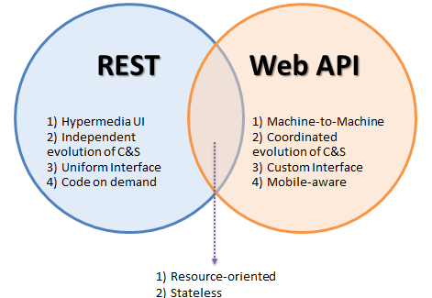
Popular API Frameworks

Slide 10
HTTP API Verbs
HTTP
GET
POST
PUT
DELETE

Slide 11
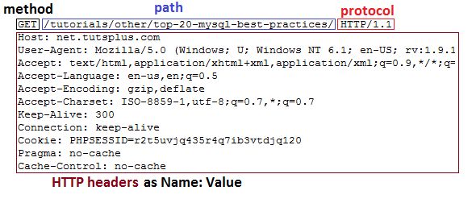
HTTP GET Header

Slide 12
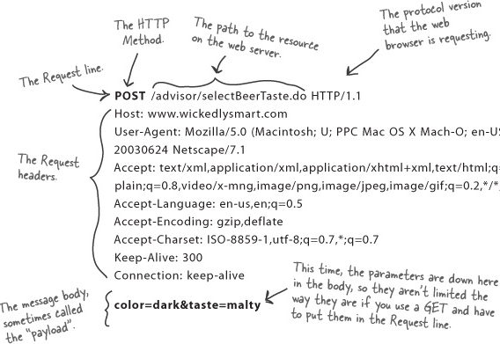
HTTP POST Header

Slide 13
Weather API
https://rapidapi.com/weatherapi/api/weatherapi-com

Slide 14
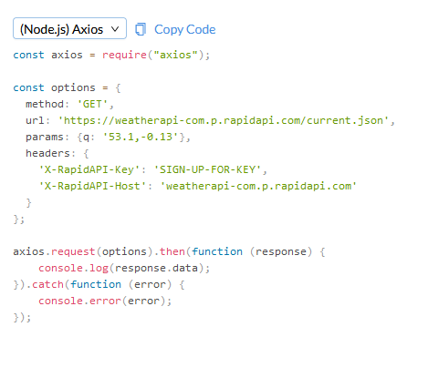
Notes:
So let’s take a look at what an API actually looks like in practice.

Slide 15
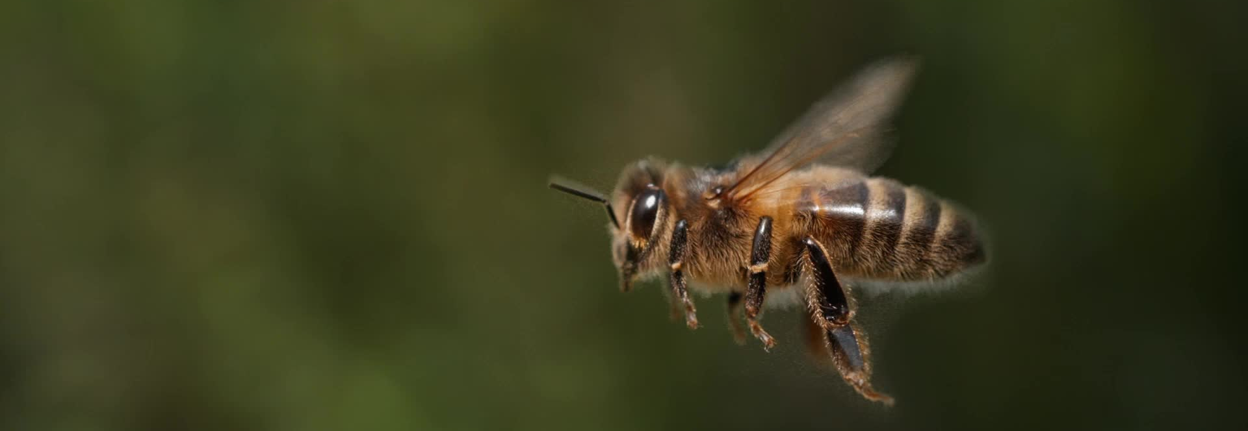

Securing APIs

Slide 16


What is Oauth?

Slide 17
How does oauth work?

Slide 18
The Software Development Life Cycle
Notes:
Over the last couple of days, we’ve talked a lot about the types of software we may interact with in our lives. We now have a sense of scale of how large of a project it is to build an app, so the question for us becomes; how do we approach this project with as much organization as possible? That’s where the software development life cycle comes into play

Slide 19
What is the Software Development Life Cycle?
The SDLC helps us organize the process of building software
Includes steps for building, revising, and deploying software
Includes roles associated with each step along the building process

Slide 20
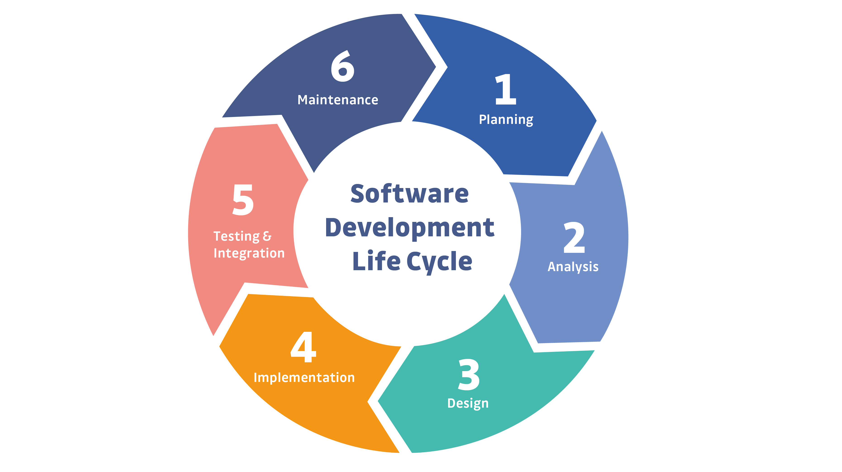
Notes:
This is a simple example of the SDLC. Typically, representations of the SDLC will have around 6 steps, but the steps will generally match what you see here.

Slide 21

Question or clarifications?

Slide 22

Questions?

Slide 23

Review Day 2

Slide 24

Preview day 3

